Slide 1
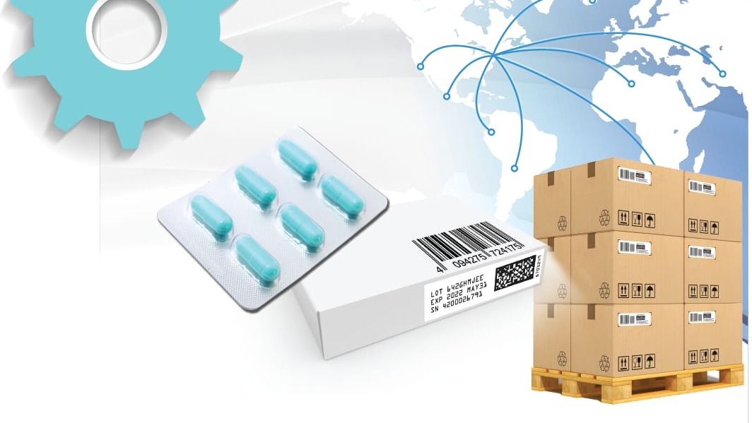
SERIALIZATION
IMPORTANCE IN PHARMA INDUSTRY

Slide 2
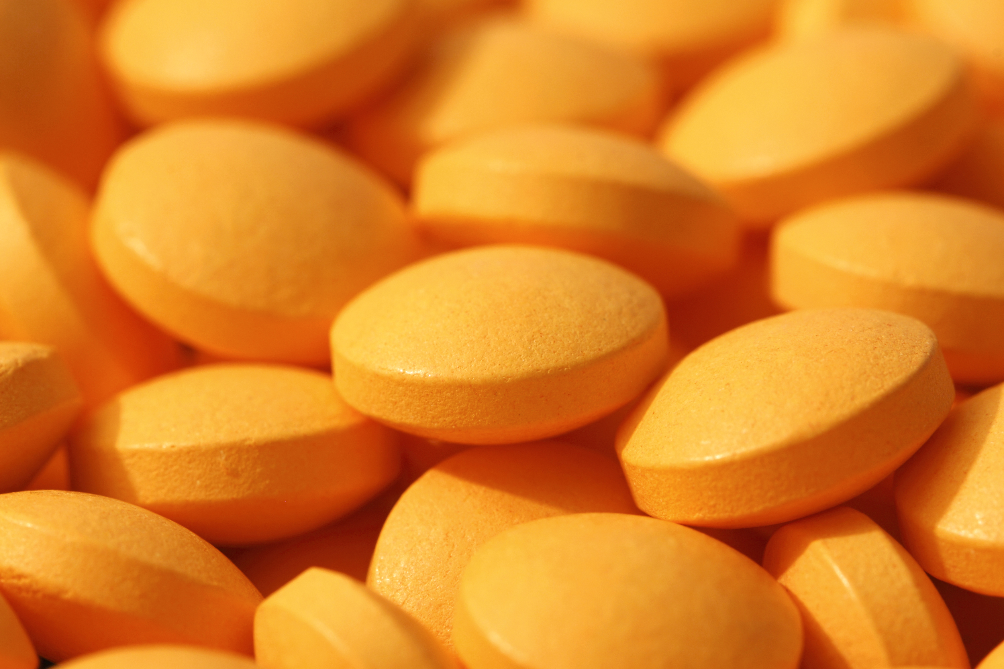
Contents: 1.Why serialization needed in pharma? 2.How Serialization helps in pharmaceutical packaging? 3.Packaging levels 4.Data Storage 5.Benefits through the System 6.Conclusion

Slide 3

1.Why serialization needed in pharma ?
Serialization identifies every product within a supply chain by a unique serial number and in addition to the origin ,shelf life and the batch number.
Serialization can also trace the pharmaceutical product from production through distribution to patient

Slide 4
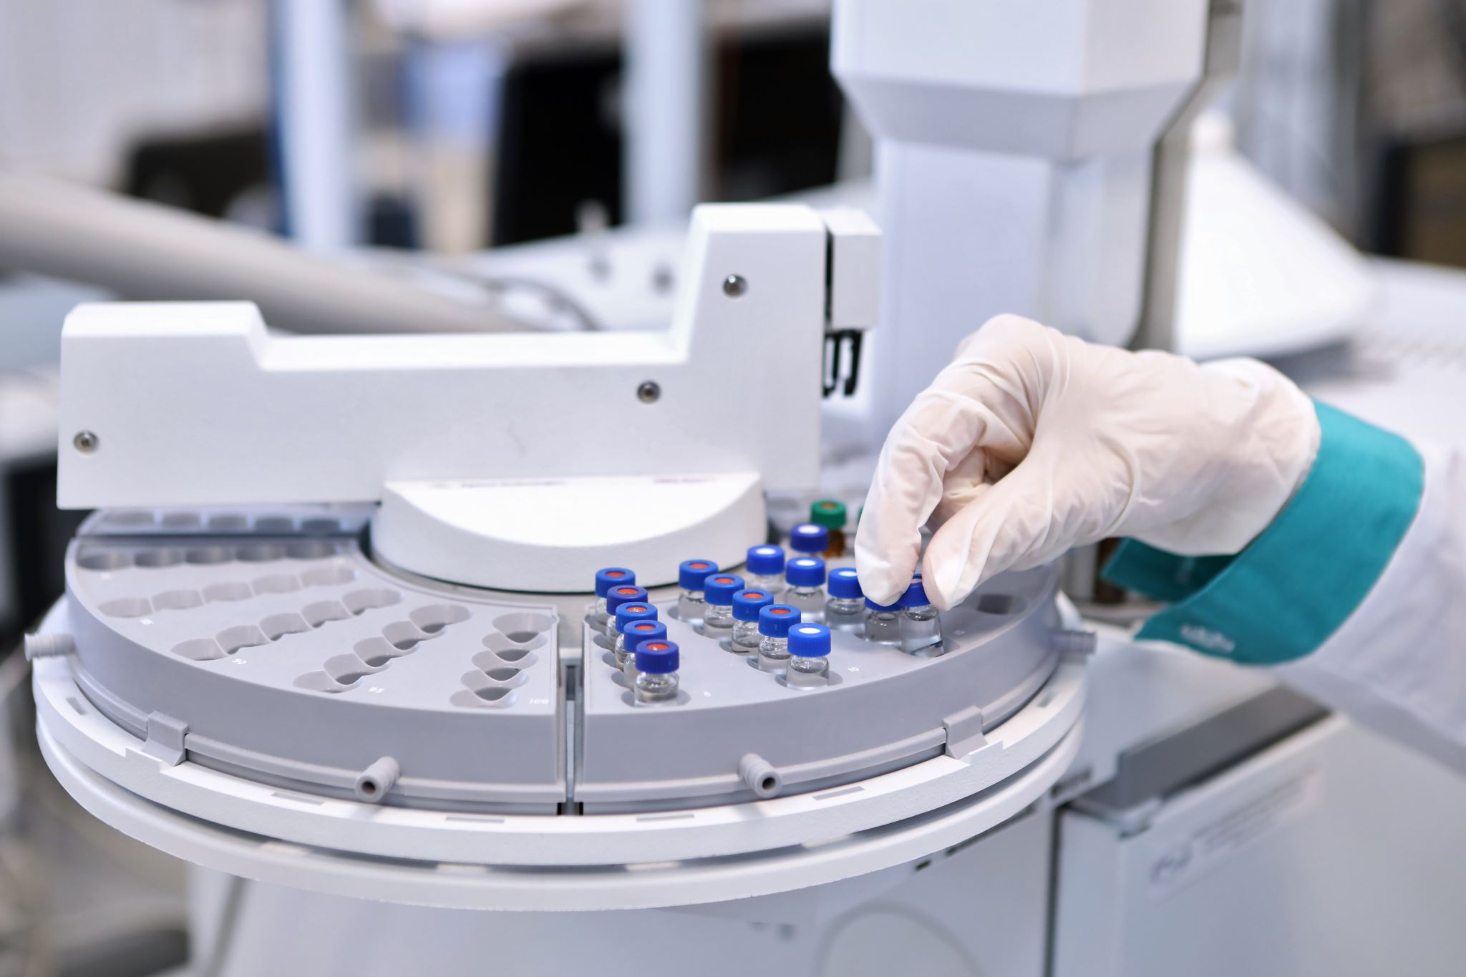
2.How Serialization helps in pharmaceutical packaging?
Serialization in Pharmaceutical packaging is the process of assigning and Labelling a unique serial number for each product to be sold.

Slide 5
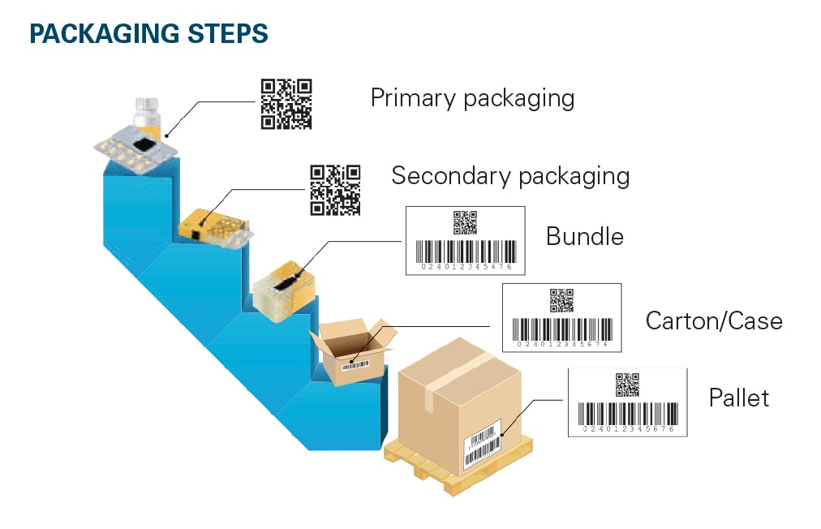
3.Packaging levels
Primary level
Secondary Level
Tertiary Level
Aggregating to SSCC
Sending EPCIS data

Slide 6
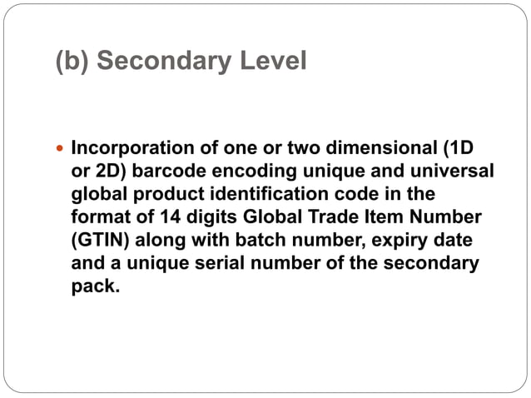
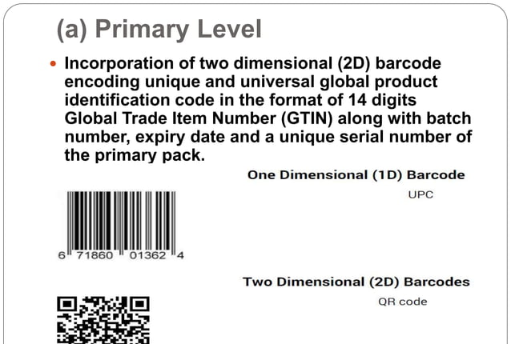
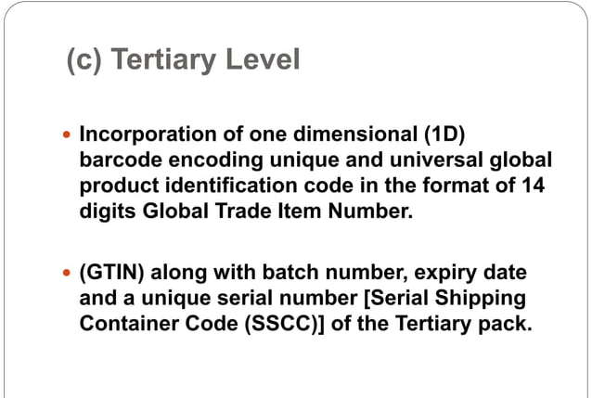

Slide 7
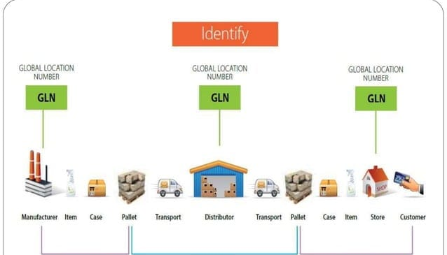
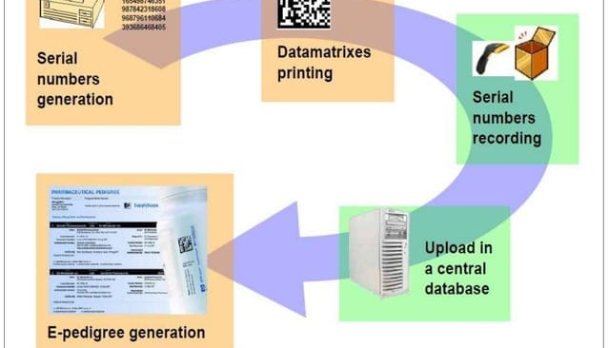
4.Data Storage:
The manufactures shall maintain the data in parent-child relationship for all the packaging levels and their movements in the supply chain.
Applications like Trace Link ,Rfxel , SAP, Lspedia and others were using for EPCIS data transmission to partners ,Whole sellers and distributors, or its designated agency and also using for Exchanging of serial numbers in the packaging levels.

Slide 8


5.Benefits:
Supply chain visibility and prevent diversion
Protects patients through improved product security
Improves customer confidence:physician,pharmacist and patient
Helps company gain greater insights into demand patterns and inventory management
Efficient and quick product recall.

Slide 9
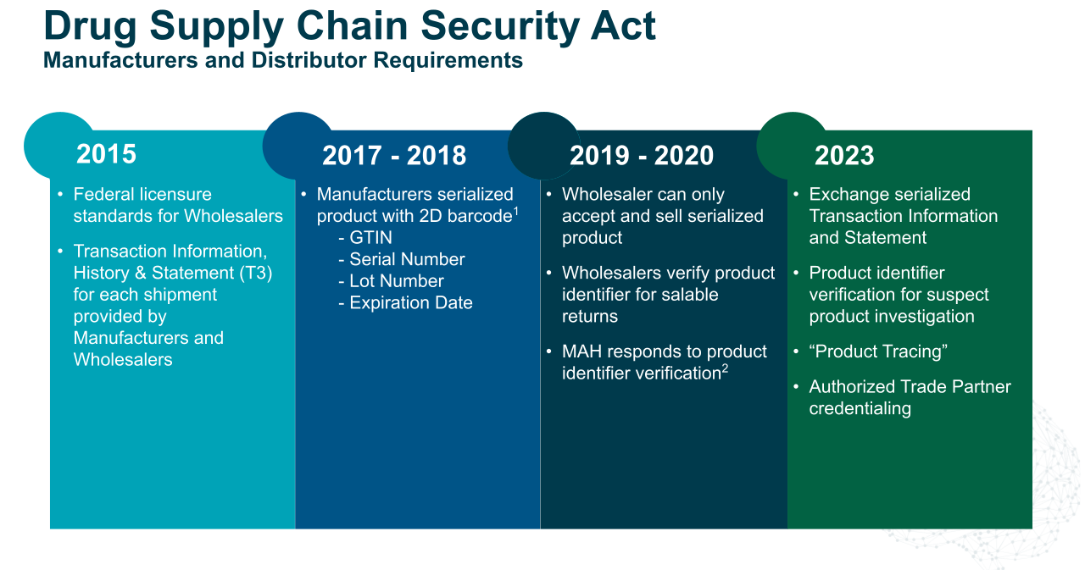

Slide 10
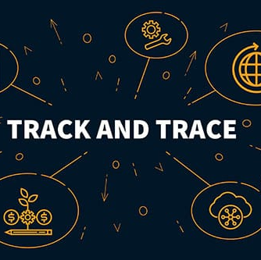
6.Conciusion:
In recent years, track and trace systems have shown to be an effective tool for increasing pharmaceutical companies competitiveness and capacity to prevent thefts and counterfeiting, while reducing recall frequency and costs.

